Slide 1

Welcome
Department of Computer Science & Engineering
Software Development Lab IV
CSE-3100

Slide 2

Project Name: Hotel Management System Project Type: Website based Application
Project Members:
Mushfiqur Rashid Khan
ID: 15-01-04-086
Anika Rahman
ID: 16-02-04-012

Slide 3

Overview
A 5-star hotel management system
Two panels are available, User panel and Admin panel
Users can visit the website to know the basic information
Admins can update information when it is necessary
Lots of beautiful pictures are available in the gallery
Users can book the rooms when they want to stay here
Beautiful dining and meeting rooms are available

Slide 4
Reason of Project Selection
Some problems are faced to get information about a 5-star hotel
Users can rarely get information about the price of the rooms to stay
Beautiful dining and meeting rooms are not available in every hotel
Users can rarely get the pictures of the hotels
Users face some problems to book the hotels online
Users cannot know the menu of the foods in the hotel

Slide 5
Project Requirements
Front End Design: Hyper Text Markup Language(HTML5), CSS3
Back End Design/Coding: PHP
Software Requirement: Notepad++ v7.5.8 (Editor), XAMPP v3.2.2 (Localhost Server with Database)
Hardware Requirement: Windows 10 Operating System
Database: SQL(PHP MyAdmin and MySQL)
External Resource: Books and Internet

Slide 6
Project Goals
To provide information about a 5-star hotel
To inform the price of the rooms
To show the beautiful pictures of the hotel
To provide various information about dining and meeting room
To book the meetings and rooms online
To inform about the food menu of the hotel
To keep information about the users

Slide 7
Panels
User Panel
Panels
Admin Panel

Slide 8
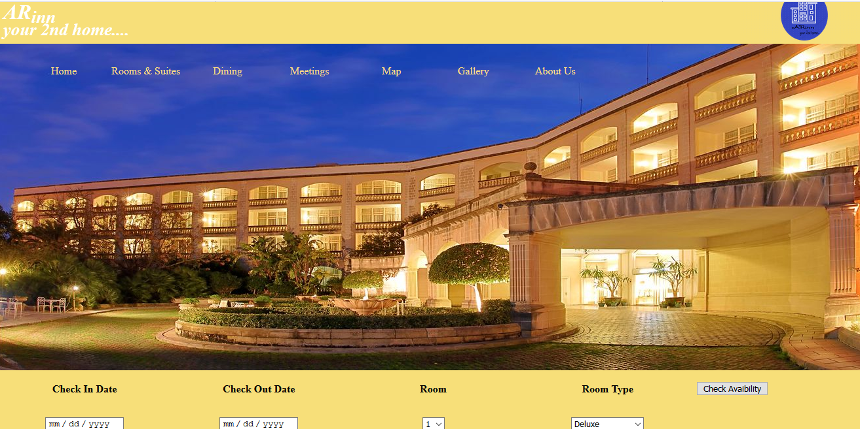
Features
User Panel
Home
Rooms and Suits
Dining
Meetings
Map
Gallery
About us

Slide 9
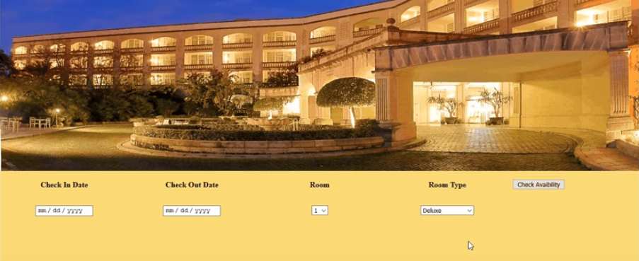
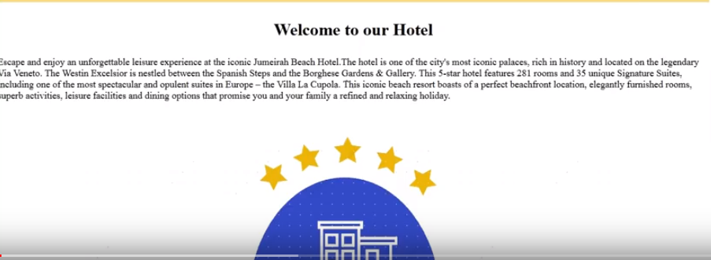
Feature Description
Home(User Panel)
This is the homepage of this hotel. In this page, the facilities of this hotel is described. Users can check in and check out in this page. They can also check the availability of their expected room.

Slide 10
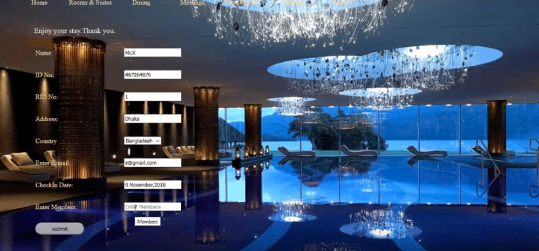
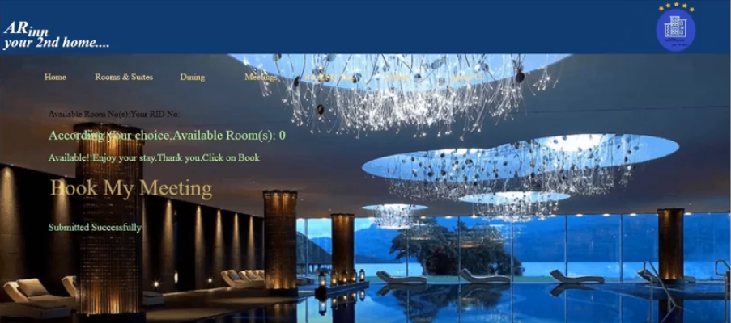
Feature Description
Home (User Panel)
According to guest’s choice, if the room is available, then user can book the room by this feature. Users have to submit their personal information to confirm their stay.

Slide 11
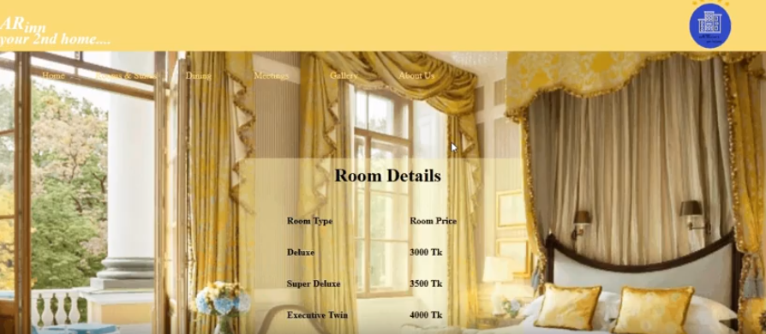
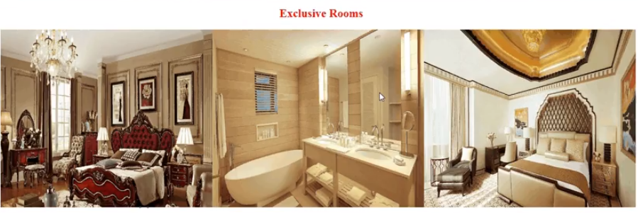
Feature Description
Rooms and Suits(User Panel)
This feature describes the detailed description of the rooms of the hotel. The different types of rooms and their photos are given here.

Slide 12
Feature Description
Rooms and Suits(User Panel)
Room types
Rooms and Suits
Prices

Slide 13
Feature Description
Dining(User Panel)
Dining Rooms
Dining
Food Menu

Slide 14
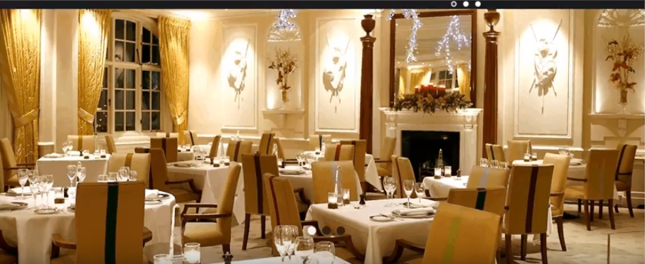
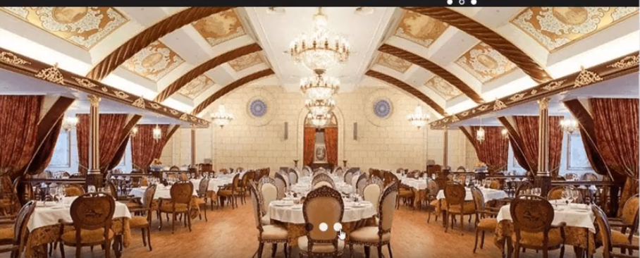
Feature Description
Dining Rooms(User Panel)
This feature describes the detailed description of the dining rooms of the hotel. The various dining rooms and their photos are given here.

Slide 15
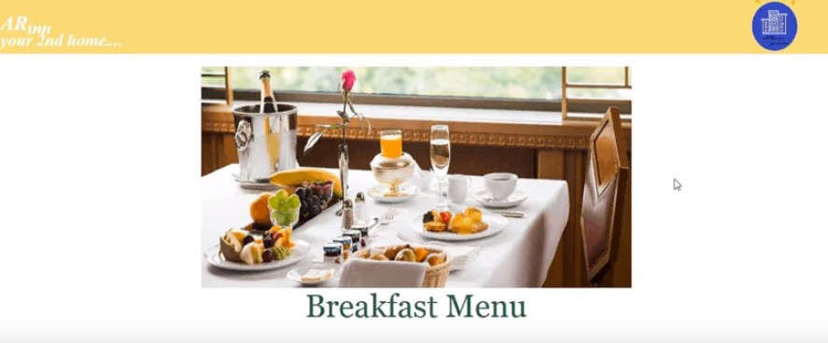
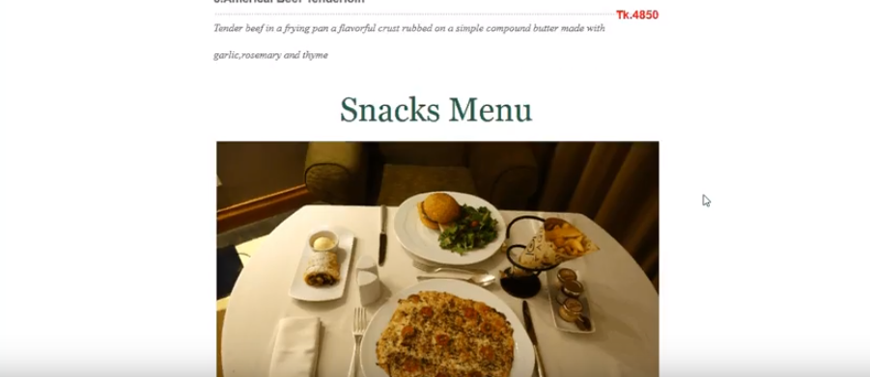
Feature Description
Food Menu(User Panel)
This feature describes the detailed description of the food menu of the hotel. The various types of foods and their photos are given here.

Slide 16
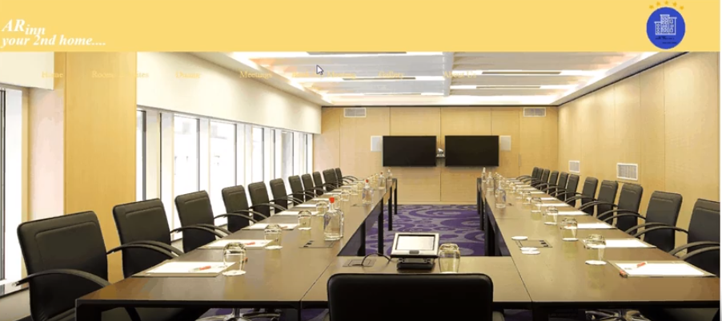
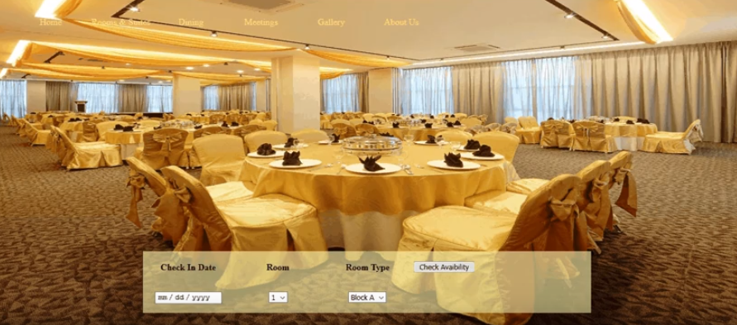
Feature Description
Meetings(User Panel)
This feature describes the detailed description of the meetings/events of the hotel. Guests can also check the availability of their preferred meeting/event room.

Slide 17
Feature Description
Meetings(User Panel)
Room types
Meetings/Event Room Details
Schedules
Room Prices

Slide 18
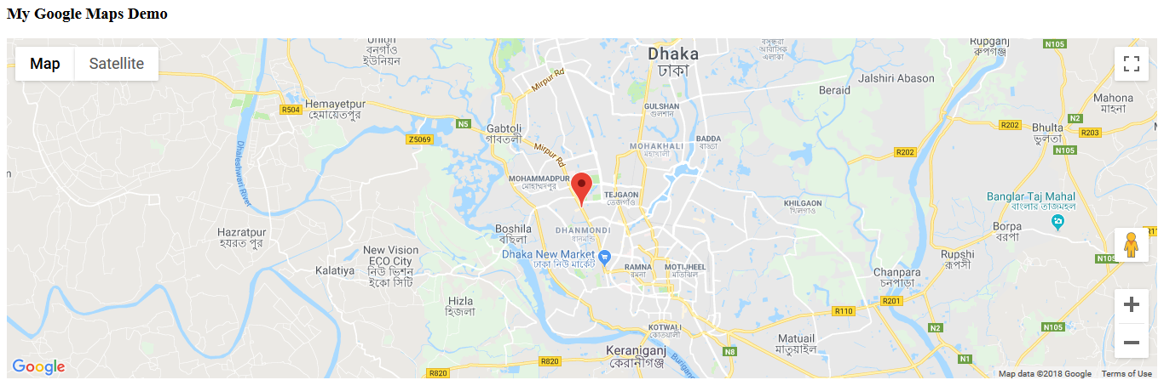
Feature Description
Map(User Panel)
This feature shows the location of the hotel by google map.

Slide 19
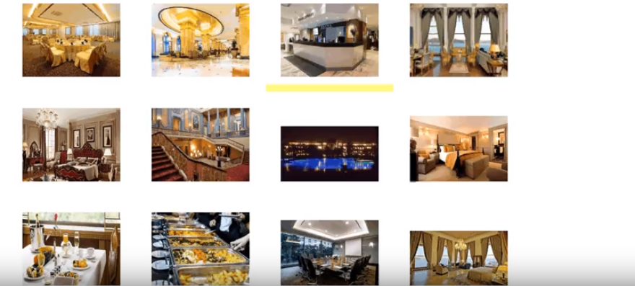
Feature Description
Gallery(User Panel)
This feature shows the different types of photos of the hotel.

Slide 20
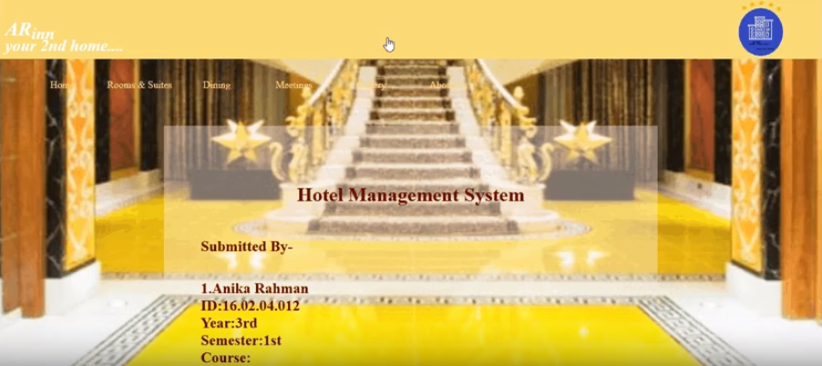
Feature Description
About us(User Panel)
This feature provides the detailed description of the contact information of the hotel.

Slide 21
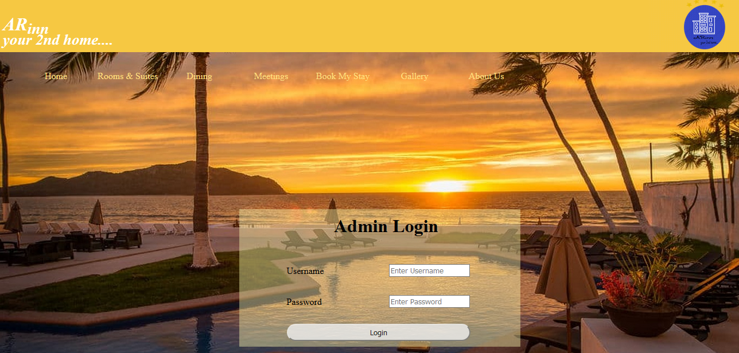
Features
Admin Panel
Home
Room Details
Admin Login
Meeting Details
Room Update
Stuff Attendance
Meeting Update
Room Booking
Add Employee
Meeting Booking
Employee Details

Slide 22
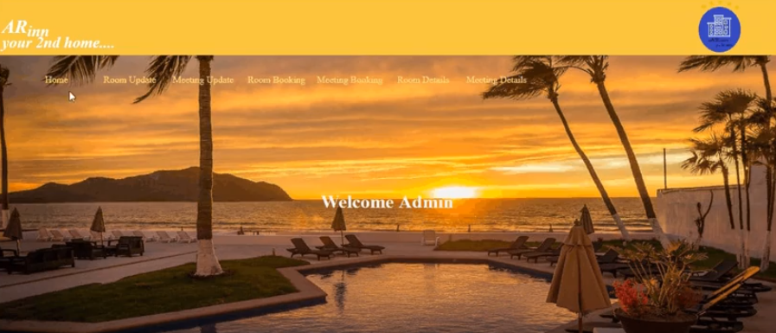
Feature Description
Home(Admin Panel)
This is the homepage for the admin of this hotel.

Slide 23
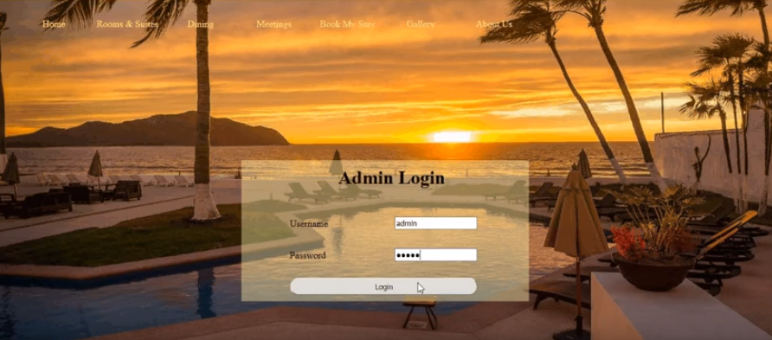
Feature Description
Admin Login(Admin Panel)
The admin must log in if he has an account. If there is no account, he must create it.

Slide 24
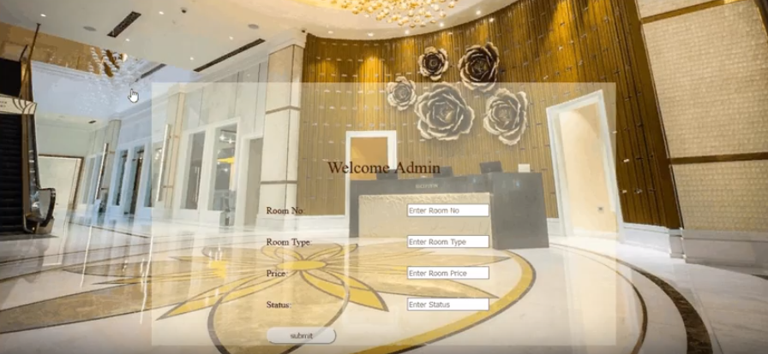
Feature Description
Room Update(Admin Panel)
This feature describes the detailed description to update information of the rooms by the admin of the hotel.

Slide 25
Feature Description
Room Update(Admin Panel)
Room No
Room types
Rooms
Status
Room Prices

Slide 26
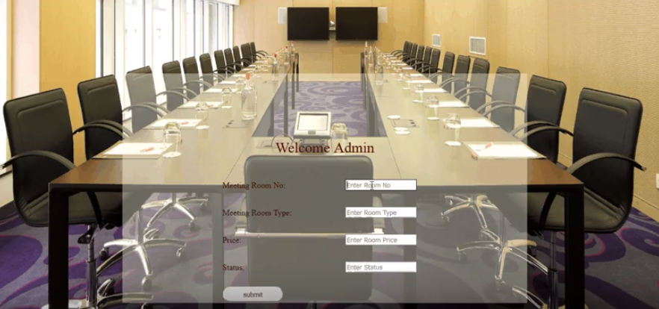
Feature Description
Meeting Update(Admin Panel)
This feature describes the detailed description to update information of the meetings by the admin of the hotel.

Slide 27
Feature Description
Meeting Update(Admin Panel)
Meeting Room No
Meeting Room types
Meetings
Status
Prices

Slide 28
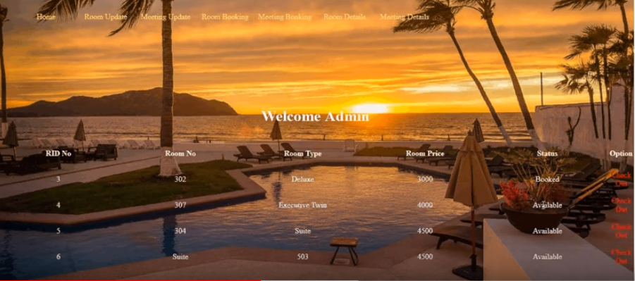
Feature Description
Room Details(Admin Panel)
This feature describes the detailed description the updated information of the rooms. Admin also can know the status of the room. If any guest checks out, then admin clicks on ‘Check Out’ and status will change into ‘Available’.

Slide 29
Feature Description
Room Details(Admin Panel)
RID No
Room No
Room types
Room Details
Status
Room Prices
Option

Slide 30

Feature Description
Meeting Details(Admin Panel)
This feature describes the updated information of the meetings/events by the admin of the hotel. Check Out feature is also available here.

Slide 31
Feature Description
Meeting Details(Admin Panel)
RID No
Meeting Details
Meeting Room types
Status
Room Prices
Option

Slide 32
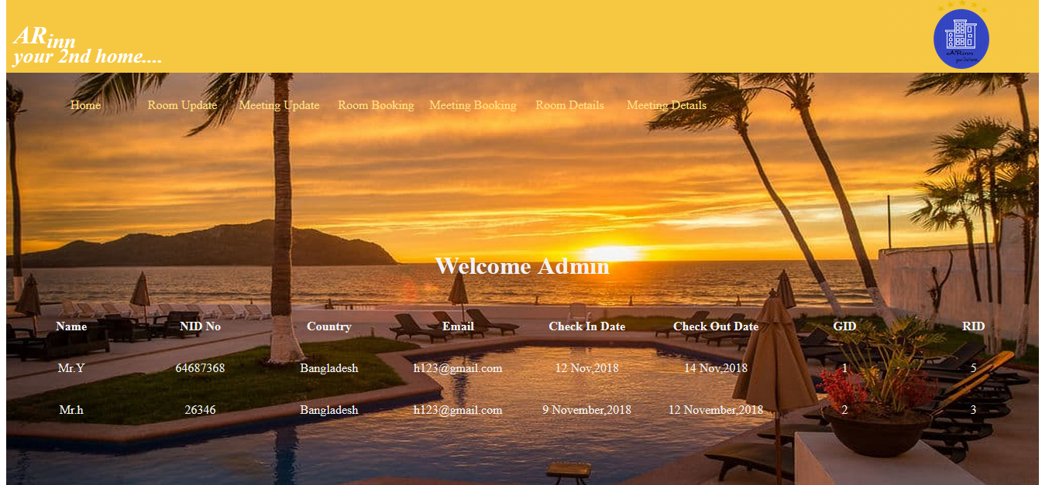
Feature Description
Room Booking(Admin Panel)
This feature describes the detailed description of guests who has booked rooms at the hotel.

Slide 33
Feature Description
Room Booking(Admin Panel)
Check in Date
Room No
Room Bookings
Room Type
Check Availability

Slide 34
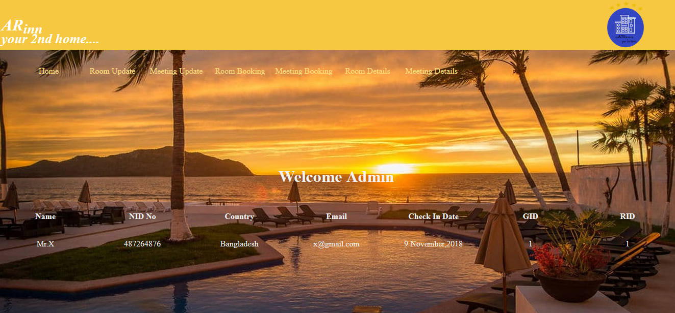
Feature Description
Meeting Booking(Admin Panel)
This feature describes the detailed description of guests who has booked Meeting/Event room(s) at the hotel.

Slide 35
Feature Description
Meeting Booking(Admin Panel)
Name
ID No
RID No
Meeting Booking
Address
Country
Check in Date

Slide 36
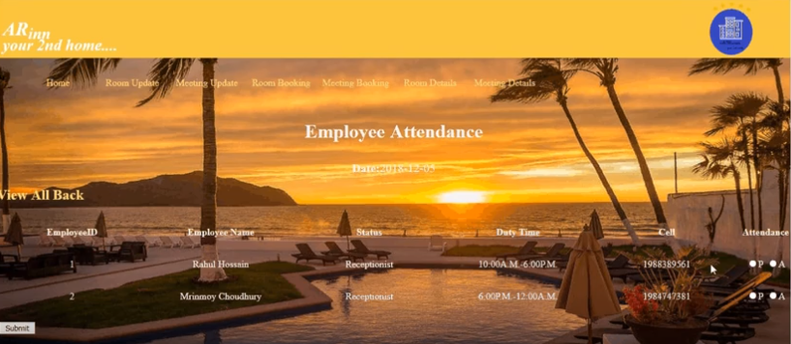
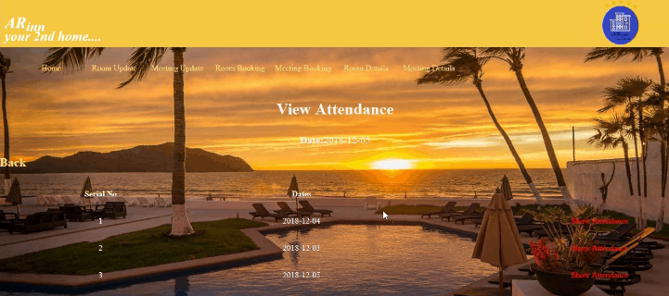
Feature Description
Staff Attendance(Admin Panel)
This feature describes the detailed information of the attendance of the employee working in the hotel.

Slide 37
Feature Description
Staff Attendance(Admin Panel)
Employee Name
Employee NID
Staff Attendance
Status
Salary
Cell No
Duty Time

Slide 38
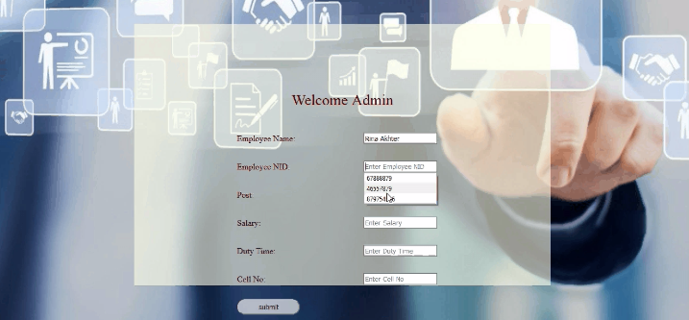
Feature Description
Add Employee(Admin Panel)
This feature adds the information of the new employees recently joined in the hotel.

Slide 39
Feature Description
Add Employee(Admin Panel)
Employee Name
Employee NID
Post
Add Employee
Salary
Cell No
Duty Time

Slide 40
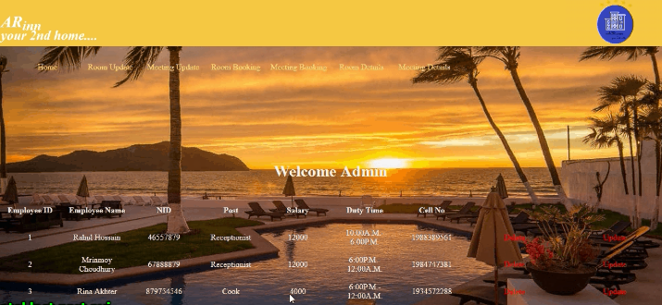
Feature Description
Employee Details(Admin Panel)
This feature describes the detailed updated information of the employee who are working in the hotel.

Slide 41
Feature Description
Employee Details(Admin Panel)
Employee ID
Employee Name
Employee NID
Post
Employee Details
Salary
Cell No
Duty Time

Slide 42
Entity Relationship Diagram
Description
Table Name | Attributes
Admin | un,ps
Form | id,name,rid,address,country,email,cidate,codate,members,adult,child,idno
Room | id,rno,rtype,rprice,status
Mform | id,name,rid,address,country,email,cidate,members,idno
Mroom | id,rno,rtype,rprice,status
Employee | id,name,NID,type,salary,time,cell
Attendance | Id,employee_ID,employee_Name,attend,atnd_time

Slide 43
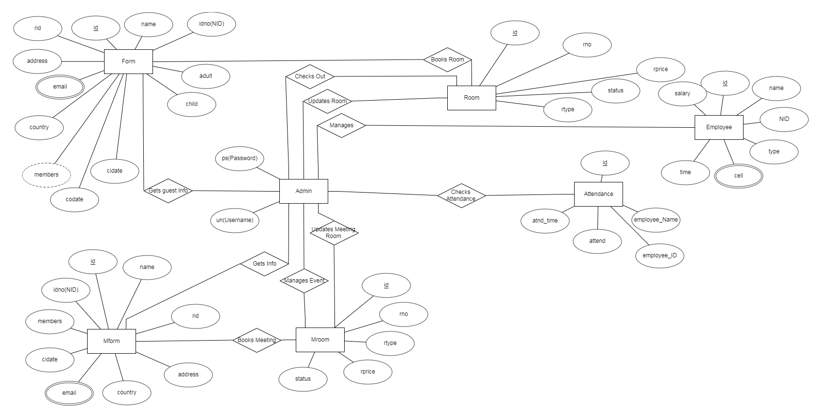
Entity Relationship Diagram
Diagram

Slide 44
Feature Description
Future Plan
Weather Forecast
Impossible to implement at this moment
Needs some advanced process to implement this
Lack of advanced process
Need to implement in future

Slide 45
Feature Description
Conclusion
That’s all about the project we have done so far. We have completed this project before the final submission as possible as we can. We hope, this project will help the users and it will be helpful to enjoy the stay for the users. Thank you so much.

Slide 46
Any Questions???

Slide 47
Thank you!!

